Slide 1




Investigating language learning and morphosyntactic transfer longitudinally using artificial languages
Pablo Bernabeu¹, Gabriella Silva², My Ngoc Giang Hoang¹, Vincent deLuca¹,
Jason Rothman^{1,2}, Claudia Poch³, Iva Ivanova³, Jorge González Alonso^{2,1}
¹ UiT The Arctic University of Norway | ² Nebrija University | ³ University of Texas at El Paso
We are grateful for the help and advice we received from Merete Anderssen, Gaute Berglund, Anders Gabrielsen, Mona Kirkness Fossum, Tekabe Legesse Feleke, Björn Lundquist, Natalia Mitrofanova, Yulia Rodina and Marit Westergaard.

Slide 2
Morphosyntactic transfer in L3 acquisition

Slide 3
Morphosyntactic transfer in L3 acquisition
Confounds when using natural languages: age of acquisition, frequency of use, proficiency level, morphological salience, etc.

Slide 4
Morphosyntactic transfer in L3 acquisition
Confounds when using natural languages: age of acquisition, frequency of use, proficiency level, morphological salience, etc.
Workaround: artificial languages
  Consistency with natural language
    Acquired by statistical learning (Hudson et al., 2005; Kidd, 2012; Monaghan et al., 2023)
    Similar processing signatures (Friederici et al., 2002; Uddén & Männel, 2018)

Slide 5
Morphosyntactic transfer in L3 acquisition
Confounds when using natural languages: age of acquisition, frequency of use, proficiency level, morphological salience, etc.
Workaround: artificial languages
  Consistency with natural language
    Acquired by statistical learning (Hudson et al., 2005; Kidd, 2012; Monaghan et al., 2023)
    Similar processing signatures (Friederici et al., 2002; Uddén & Männel, 2018)
  An extensive training in the artificial language could be necessary for standard syntactic signatures (notably, P600) to appear in ERPs (González Alonso et al., 2020; Pereira Soares et al., 2022).

Slide 6
González Alonso et al. (2020)
Participants: L1 Spanish, L2 English
Artificial language groups: Mini-Spanish (n = 26), Mini-English (n = 24)
Grammatical property: gender agreement between nouns and predicative adjectives in copular sentences. Example:
  Mini-Spanish: Jer mochil son carejur | Jer mochil son baratejur
  Mini-English: Jer bag are expensivejur | Jer bag are cheapejur
  Translation: The bags are expensive | The bags are cheap
Session phases: vocabulary pre-training → grammatical training → test (min. 80%) → ERP experiment → gender assignment task in Spanish

Slide 7
González Alonso et al. (2020)
Results
Mini-Spanish group: broadly distributed 300–600 ms positivity, most consistent with attention-related P300.
No (N400)–P600
Interpretation: allocation of attentional resources in preparation for the selection of transfer source(s). In Mini-Spanish, larger focus on word-final gender morphology, consistent with Spanish.

Slide 8
Sessions
Session 1. Individual differences (home-based session)
  Working memory (digit span), selective attention (Stroop) and procedural memory (serial reaction time)
  Language History Questionnaire (LHQ3; Li et al., 2020)

Slide 9
Sessions
Session 1. Individual differences (home-based session)
  Working memory (digit span), selective attention (Stroop) and procedural memory (serial reaction time)
  Language History Questionnaire (LHQ3; Li et al., 2020)
+ 1 week: Session 2. Resting-state EEG + Gender agreement
  Resting-state EEG related to attention (Rogala et al., 2020), including eyes-open and eyes-closed

Slide 10
Sessions
Session 1. Individual differences (home-based session)
  Working memory (digit span), selective attention (Stroop) and procedural memory (serial reaction time)
  Language History Questionnaire (LHQ3; Li et al., 2020)
+ 1 week: Session 2. Resting-state EEG + Gender agreement
  Resting-state EEG related to attention (Rogala et al., 2020), including eyes-open and eyes-closed
+ 1 week: Session 3. Differential object marking + Gender agreement
  Training only in the new property
  Experiment part contains both properties intermixed

Slide 11
Sessions
Session 1. Individual differences (home-based session)
  Working memory (digit span), selective attention (Stroop) and procedural memory (serial reaction time)
  Language History Questionnaire (LHQ3; Li et al., 2020)
+ 1 week: Session 2. Resting-state EEG + Gender agreement
  Resting-state EEG related to attention (Rogala et al., 2020), including eyes-open and eyes-closed
+ 1 week: Session 3. Differential object marking + Gender agreement
  Training only in the new property
  Experiment part contains both properties intermixed
+ 1 week: Session 4. Verb-object agreement + Differential object marking + Gender agreement
  Same mechanism as in the previous session

Slide 12
Sessions
Session 1. Individual differences (home-based session)
  Working memory (digit span), selective attention (Stroop) and procedural memory (serial reaction time)
  Language History Questionnaire (LHQ3; Li et al., 2020)
+ 1 week: Session 2. Resting-state EEG + Gender agreement
  Resting-state EEG related to attention (Rogala et al., 2020), including eyes-open and eyes-closed
+ 1 week: Session 3. Differential object marking + Gender agreement
  Training only in the new property
  Experiment part contains both properties intermixed
+ 1 week: Session 4. Verb-object agreement + Differential object marking + Gender agreement
  Same mechanism as in the previous session
+ 1 week: Session 5. Retest of executive functions (home-based session)

Slide 13
Sessions
Session 1. Individual differences (home-based session)
  Working memory (digit span), selective attention (Stroop) and procedural memory (serial reaction time)
  Language History Questionnaire (LHQ3; Li et al., 2020)
+ 1 week: Session 2. Resting-state EEG + Gender agreement
  Resting-state EEG related to attention (Rogala et al., 2020), including eyes-open and eyes-closed
+ 1 week: Session 3. Differential object marking + Gender agreement
  Training only in the new property
  Experiment part contains both properties intermixed
+ 1 week: Session 4. Verb-object agreement + Differential object marking + Gender agreement
  Same mechanism as in the previous session
+ 1 week: Session 5. Retest of executive functions (home-based session)
+ 4 months: Session 6. Retest of all grammatical properties
  Session ends with control tests on the relevant properties in the natural languages

Slide 14
Creation of the artificial languages
Modular framework formed of interoperable components
Minimal components of each language contained in a base file
Linguistic and visual stimuli finally presented are created by assembling minimal components.
Several controls exerted on the stimuli to prevent spurious effects. For instance, gender and number are counterbalanced across experimental conditions. Similarly, words and experimental conditions within the same set appear equally often.

Slide 15
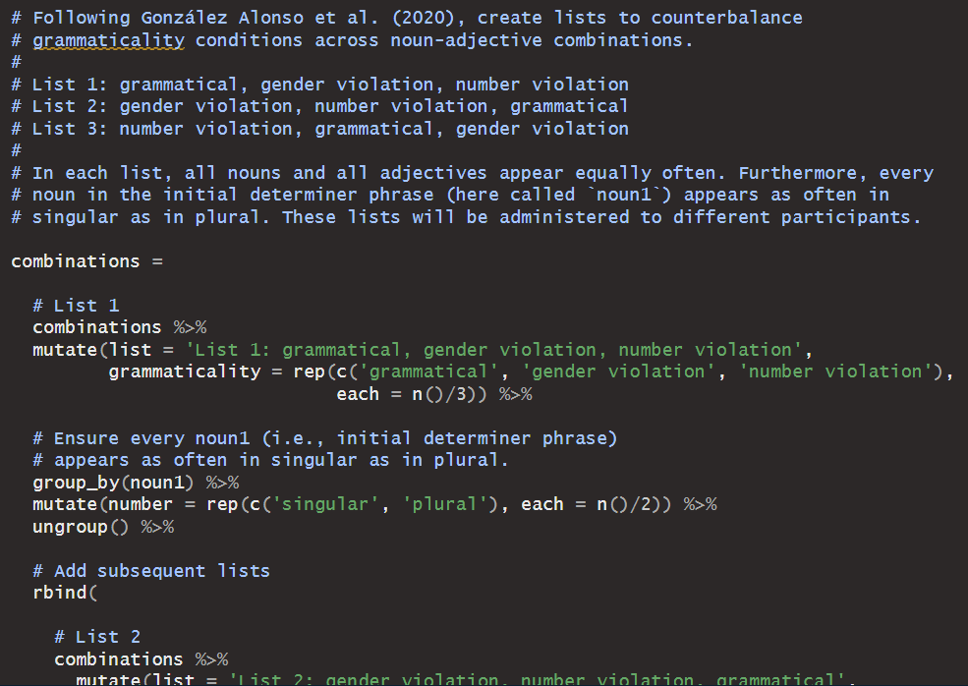

Slide 16
Creation of the artificial languages
Modular framework formed of interoperable components
Minimal components of each language contained in a base file
Linguistic and visual stimuli finally presented are created by assembling minimal components.
Several controls exerted on the stimuli to prevent spurious effects. For instance, gender and number are counterbalanced across experimental conditions. Similarly, words and experimental conditions within the same set appear equally often.
All stimuli compiled through R scripts

Slide 17
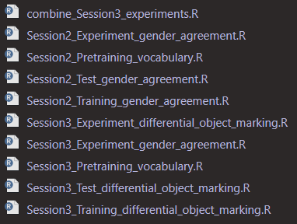
All scripts are run from a core script.

Slide 18
Creation of the artificial languages
Modular framework formed of interoperable components
Minimal components of each language contained in a base file
Linguistic and visual stimuli finally presented are created by assembling minimal components.
Several controls exerted on the stimuli to prevent spurious effects. For instance, gender and number are counterbalanced across experimental conditions. Similarly, words and experimental conditions within the same set appear equally often.
All stimuli compiled through R scripts
Present framework facilitates reproducibility and inspection of stimuli, and allows extensions
Parallel lists of stimuli used to enable some of the controls
Open-source software OpenSesame used to present the stimuli and collect responses

Slide 19
Test phase in all sessions
Grammatical
Critical morphosyntactic violation
Non-critical morphosyntactic violation
Non-critical morphosyntactic violation
Semantic violation

Slide 20
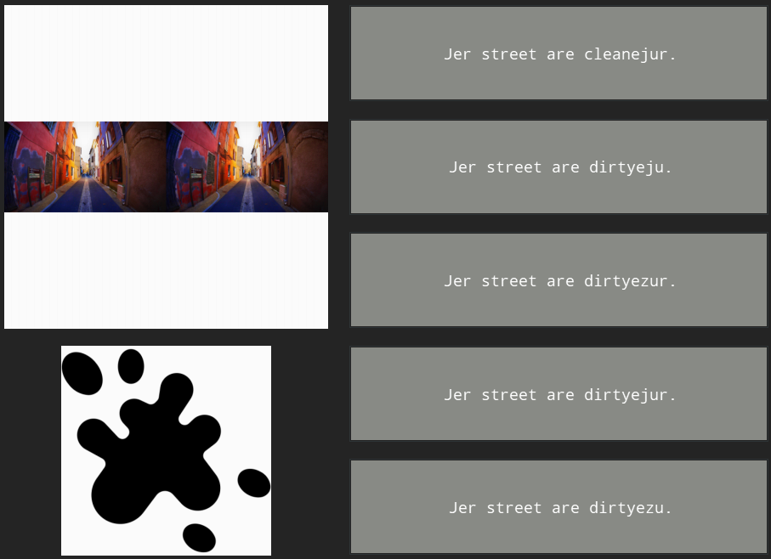

Slide 21
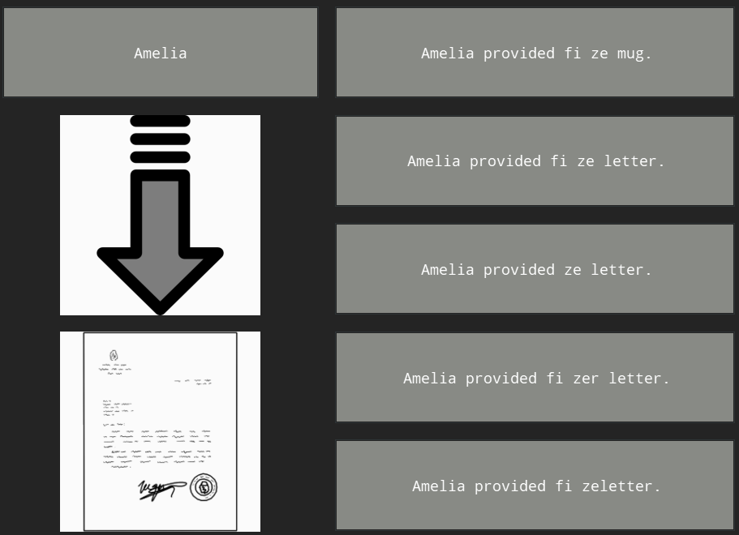

Slide 22
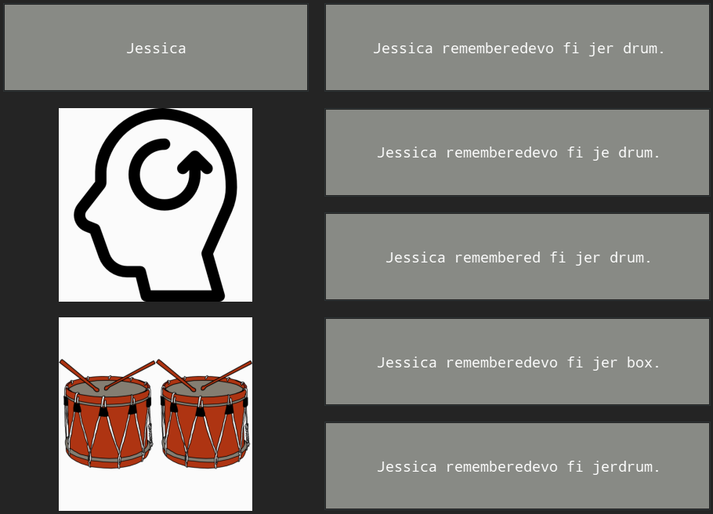

Slide 23
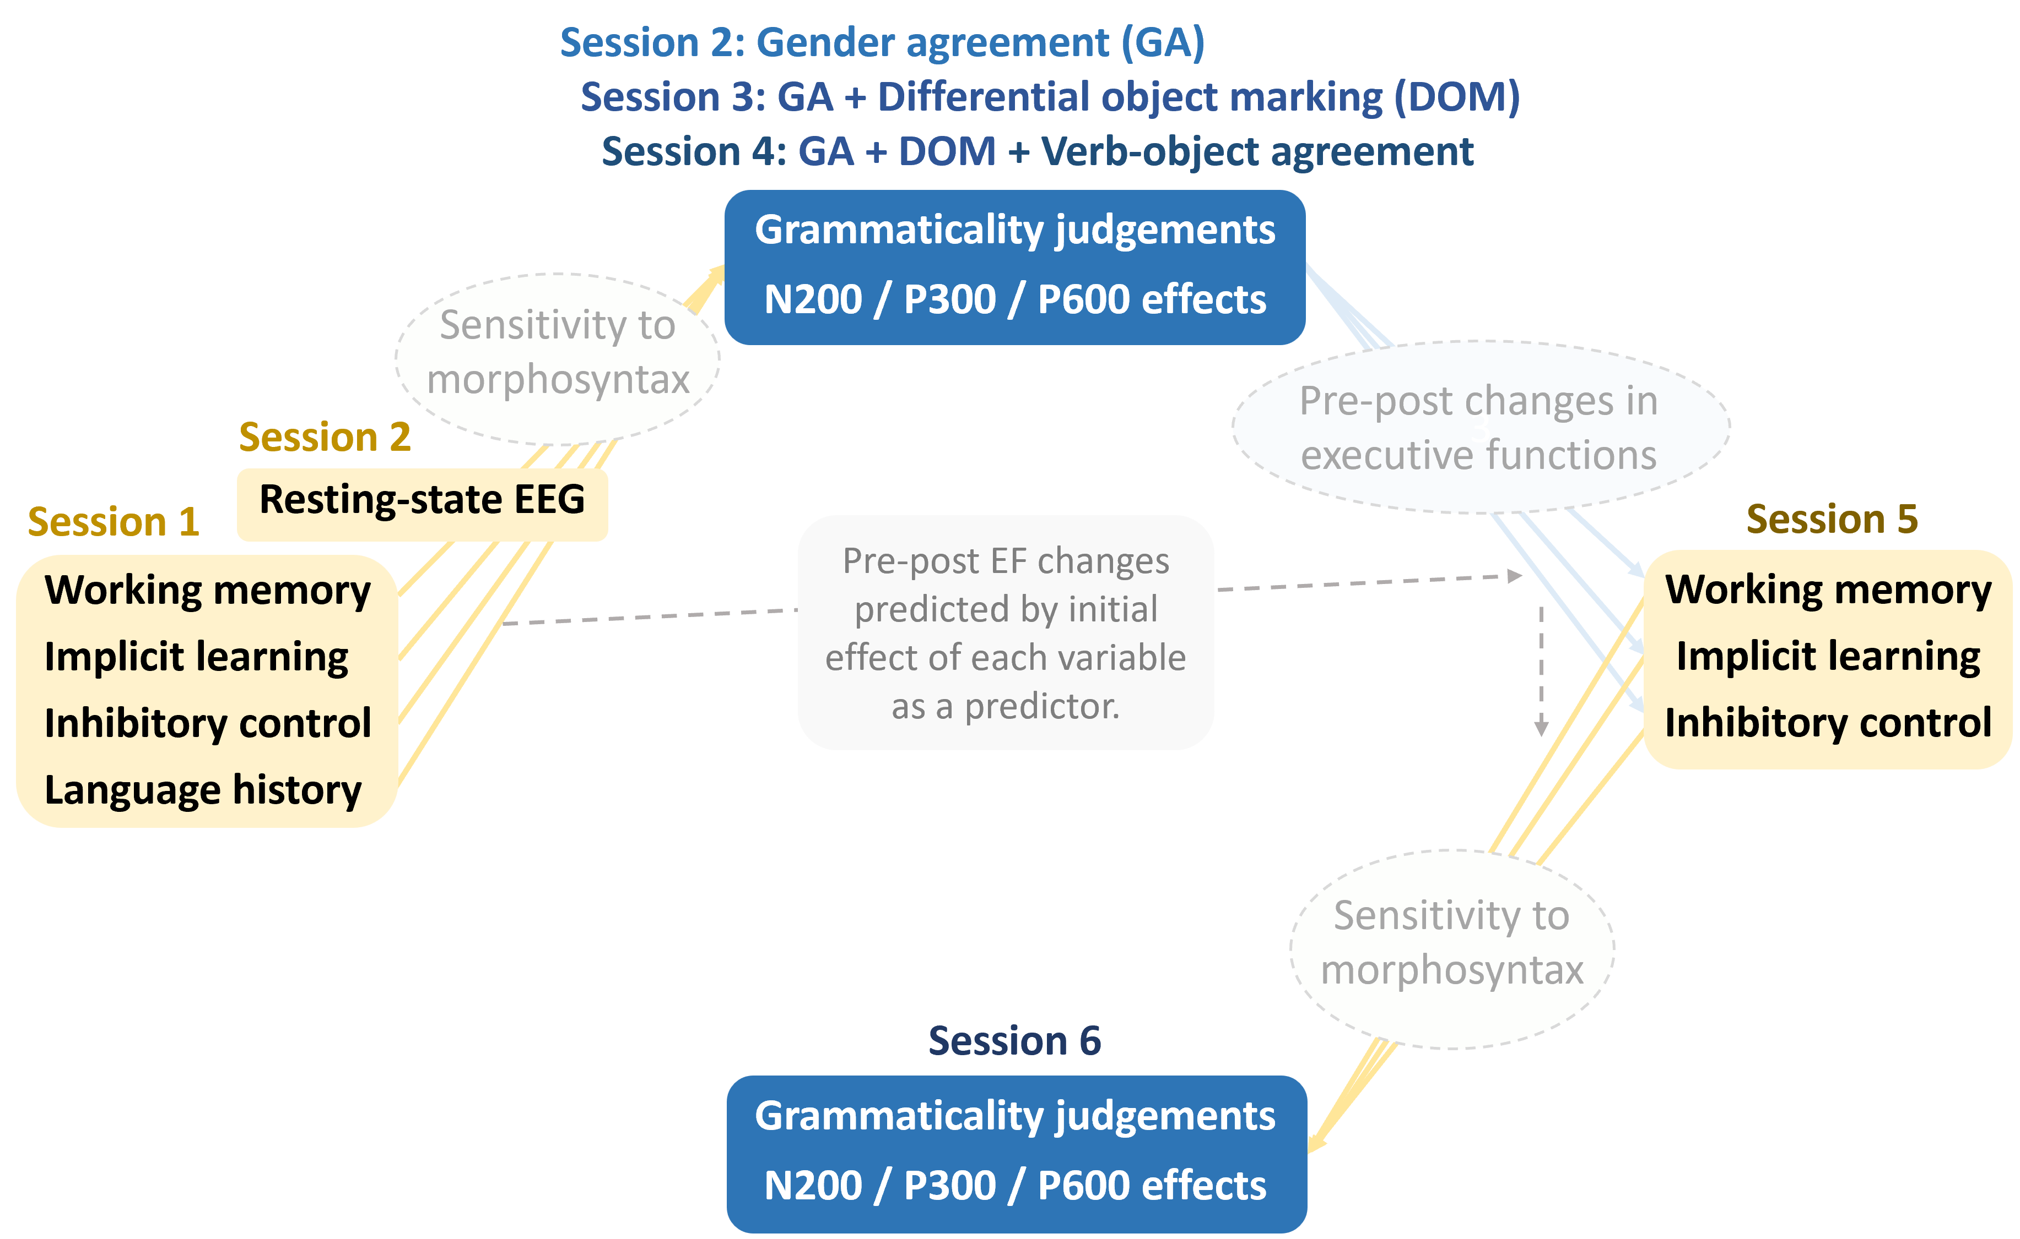

Slide 24
Executive functions and rs-EEG
Primarily methodological analyses focussed on longitudinal stability.
Analysed first as independent variables, and second as dependent variables.

Slide 25
Longitudinal role of executive functions and rs-EEG
Independent-variable analysis: longitudinal stability (i.e., test-retest reliability) of the variables (for similar analyses, see Fuhs et al., 2014; Samuels et al., 2016; Swanson, 2015).
  First analysis: longitudinal stability of the executive functions and rs-EEG on their own.
  Second analysis: longitudinal stability of the executive functions and rs-EEG as predictors of language learning and morphosyntactic transfer over time.

Slide 26
Longitudinal effects on executive functions and rs-EEG
Dependent-variable analysis: whether any cognitive changes in each executive function (incl. rs-EEG) are consistent with the baseline role of each executive function (incl. rs-EEG).
Cognitive enhancements analysed relative to the effect of each executive function (incl. rs-EEG) as a predictor of language-learning performance following first exposure—i.e., in the first test on the artificial language.
Analysis intended to increase the methodological basis for the selection of measures to study training-induced cognitive enhancements (see Grossmann et al., 2023; Kliesch et al., 2022; Meltzer et al., 2023).
Pre-post effects not analysed in absolute terms due to lack of control group (Sala & Gobet, 2017).

Slide 27
Language learning:
Analyses and hypotheses

Slide 28
Language learning
Hypothesis 1: greater executive functions (overall, incl. rs-EEG) → better language learning
Exploratory analysis: relative importance of the four executive function measures
  Hypotheses to be set a priori where possible
Hypothesis 2: greater executive functions (overall, incl. rs-EEG) → greater longitudinal improvements in language learning due to better accumulation of knowledge
Hypothesis 3: longitudinal retests in the grammatical properties → better language learning

Slide 29
Morphosyntactic transfer:
Analyses and hypotheses

Slide 30
  Standardised numeric predictions
  Effect sizes standardised between 0 and 10
  Visualisation of numerous comparisons across conditions and models
  Pave the way towards computational models with numeric predictions

Slide 31
  Standardised numeric predictions
  Effect sizes standardised between 0 and 10
  Visualisation of numerous comparisons across conditions and models
  Pave the way towards computational models with numeric predictions
Norway site predictions
Property | Artificial lang. | L2SFM | CEM | LPM | TPM
 |  | L2 default | prop. by prop. | prop. by prop. | full transfer
Gender agreement | Mini-Norwegian | 0 | 10 | 5-10 | 10
 | Mini-English | 10 | 10 | 0-5 | 0-2
Differential object marking | Mini-Norwegian | 0-3 | 0-3 | 0-2 | 0-2
 | Mini-English | 0-3 | 0-3 | 0-3 | 0-3
Verb-object number agreem. | Mini-Norwegian | 0-3 | 3 | 0-6 | 0-5
 | Mini-English | 0-3 | 3 | 0-3 | 0-3

Slide 32
Spain site predictions
Property | Group | Artificial lang. | L2SFM | CEM | LPM | TPM
 |  |  | L2 default | prop. by prop. | prop. by prop. | full transfer
Gender agreement | L1 Eng, L2 Spa | Mini-Spanish | 10? | 10 | 5-10 | 10
 | L1 Eng L2 Sp | Mini-English | 10? | 10 | 5-7 | 0
 | L1 Spa, L2 Eng | Mini-Spanish | 0 | 10 | 5-10 | 10
 | L1 Sp L2 Eng | Mini-English | 0 | 10 | 0-5 | 0
Differential object marking | L1 Eng, L2 Spa | Mini-Spanish | 8? | 8 | 5-8 | 8
 | L1 Eng L2 Sp | Mini-English | 8? | 8 | 0-5 | 0-2
 | L1 Spa, L2 Eng | Mini-Spanish | 0 | 8 | 5-8 | 8
 | L1 Sp L2 Eng | Mini-English | 0 | 8 | 0-5 | 0-2
Verb-object number agreement | L1 Eng, L2 Spa | Mini-Spanish | 0-5? | 0-3 | 0-4 | 0-3
 | L1 Eng L2 Sp | Mini-English | 0-5? | 0-3 | 0-2 | 0-2
 | L1 Spa, L2 Eng | Mini-Spanish | 0-3 | 0-3 | 0-4 | 0-3
 | L1 Sp L2 Eng | Mini-English | 0-3 | 0-3 | 0-3 | 0-2

Slide 33


Executive functions and morphosyntactic transfer
Hypothesis 1: greater executive functions (overall, incl. rs-EEG)
→ greater precursors of transfer (N2, P3)
Hypothesis 2: greater executive functions (overall , incl. rs-EEG)
→ greater signatures of transfer (P600)

Slide 34

Longitudinal effects in morphosyntactic transfer
Hypothesis 1: any signatures of transfer (esp. P600) more likely to occur in later sessions.
Hypothesis 2: any signatures of transfer (esp. P600) should persist in subsequent sessions.

Slide 35
Main references (others available upon request)
González Alonso, J., Alemán Bañón, J., DeLuca, V., Miller, D., Pereira Soares, S. M., Puig-Mayenco, E., Slaats, S., & Rothman, J. (2020). Event related potentials at initial exposure in third language acquisition: Implications from an artificial mini-grammar study. Journal of Neurolinguistics, 56, 100939.
Morgan-Short, K., Finger, I., Grey, S., & Ullman, M. T. (2012). Second language processing shows increased native-like neural responses after months of no exposure. PLOS ONE, 7(3), e32974.
Pereira Soares, S. M., Kupisch, T., & Rothman, J. (2022). Testing potential transfer effects in heritage and adult L2 bilinguals acquiring a mini grammar as an additional language: An ERP approach. Brain Sciences, 12(5), Article 5.
Rogala, J., Kublik, E., Krauz, R., & Wróbel, A. (2020). Resting-state EEG activity predicts frontoparietal network reconfiguration and improved attentional performance. Scientific Reports, 10(1), 5064.
Rothman, J., Alemán Bañón, J., & González Alonso, J. (2015). Neurolinguistic measures of typological effects in multilingual transfer: Introducing an ERP methodology. Frontiers in Psychology, 6.

